Slide 1
2016-2019 Nashville Rock and Roll Full and Half marathon Analysis
g. Seibert Tregoning – April 15, 2020

Slide 2
Question 2:
Use built-in functions to answer the following questions. Be sure to display your analysis work in a neat, easy-to-follow format.
Find the fastest time, slowest time, median, and mean times for each of the 8 races.
Find the mean and median marathon finish times for all 4 years combined.
Find the mean and median half-marathon finish times for all 4 years combined.

Slide 3
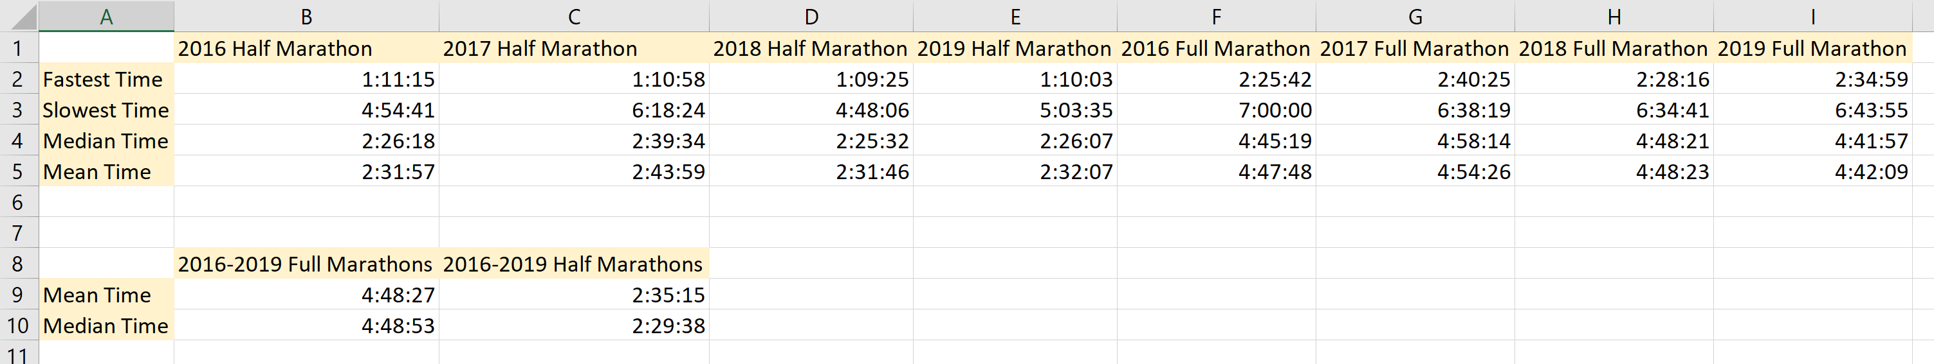
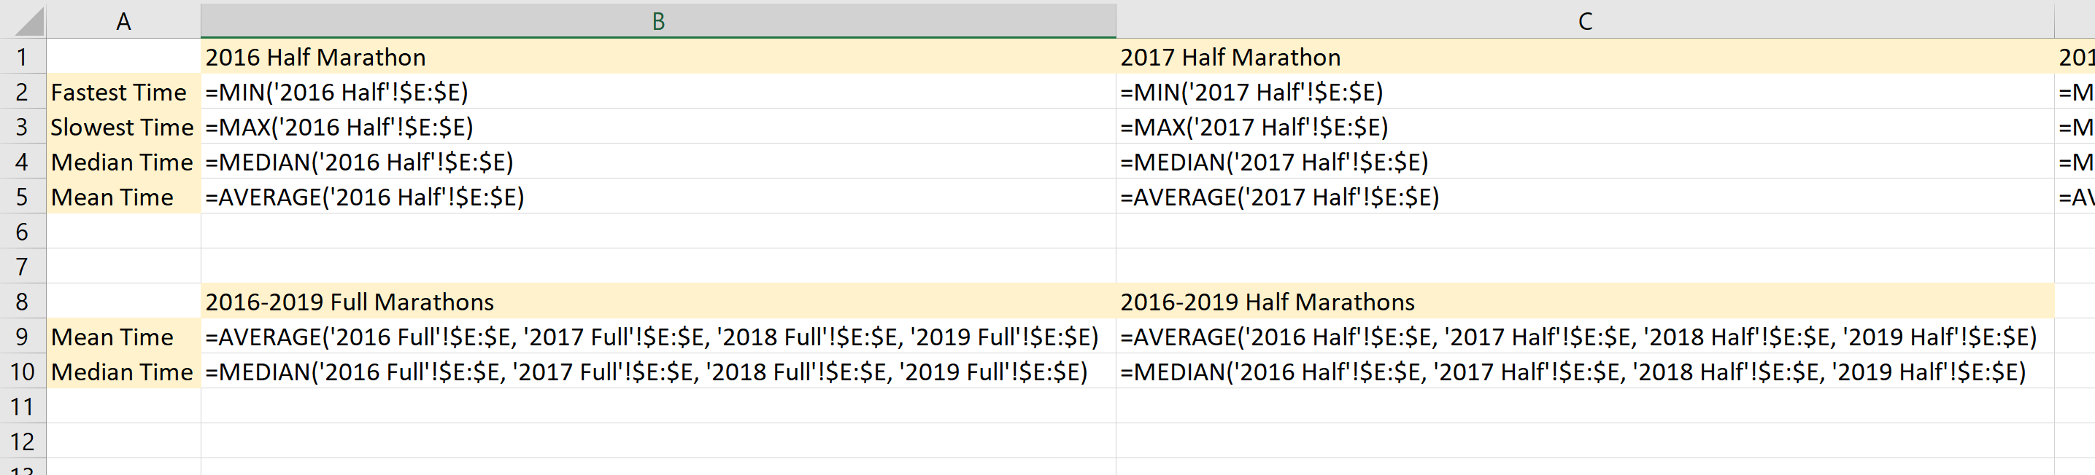
Question 2 Answers:

Slide 4
Question 3:
First time marathoners sometimes set a goal of beating “Oprah’s time,” Oprah Winfrey’s time (04:29:20) in the 1994 Marine Corps Marathon when she was 40 years old.
How many runners each year beat Oprah’s time?
What percentage of runners in each of the 4 marathons beat Oprah’s time?

Slide 5
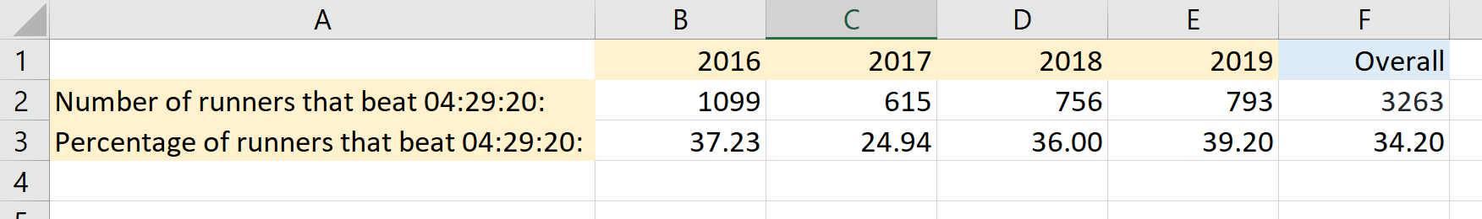
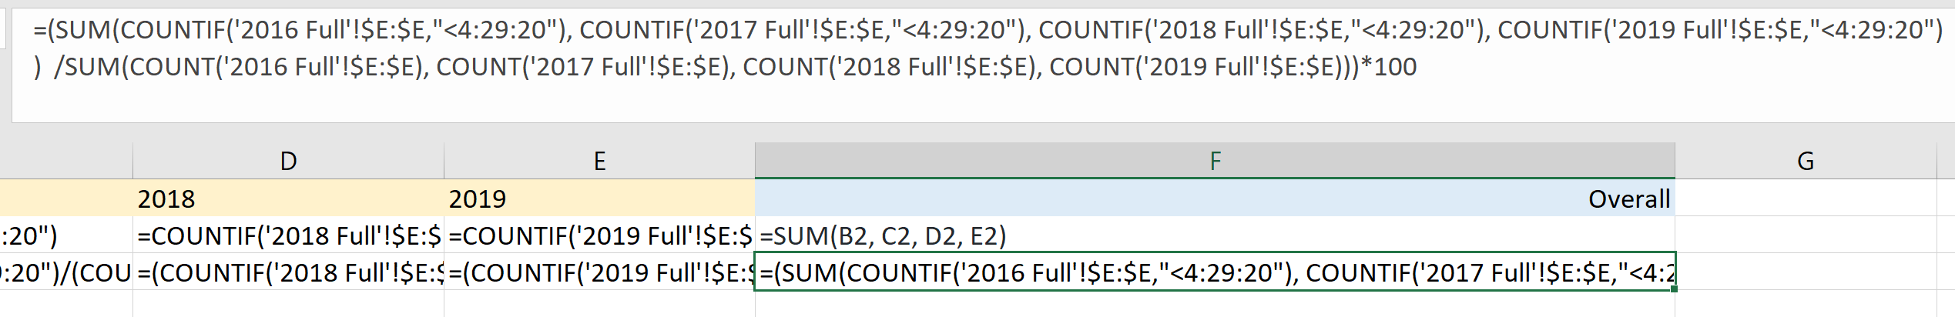
Question 3 ANswers:

Slide 6
Question 4:
Quartiles help group data into buckets – the first quarter of data is the first quartile, the second quartile (same as the median) is the first half of the data, and the third quartile represents the first 75 percent. Find the values that define the first, second, and third quartiles for each half-marathon.

Slide 7
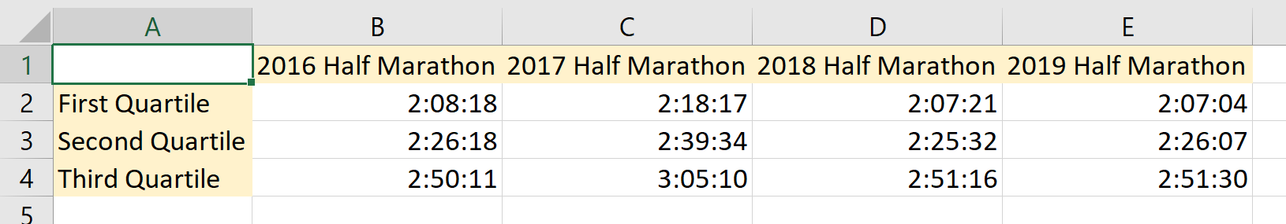
Question 4 AnswerS:

Slide 8
Question 5:
Is there a year in which runners seem slower or faster? Formulate a hypothesis for any apparent differences.

Slide 9
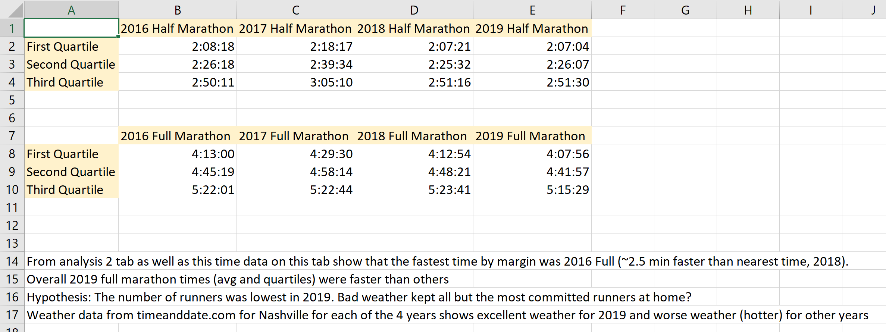
Question 5 Answers:

Slide 10
Question 6:
Scott Wietecha has won the Rock and Roll Marathon for 7 years in a row. Compute and display the difference between Wietecha’s time and the next fastest runner for each year.

Slide 11
Question 6 Answers:

Slide 12
Bonus Question:
Find the top three runners for 2016, 2017, 2018, and 2019. Remove any duplicates across years (i.e., Scott Wietecha should only be in the list once). How many unique runners finished at one of the top 3 spots in the past 4 races? In how many of the 4 years did each top 3 runner finish? How has each runner’s time changed from year to year?

Slide 13
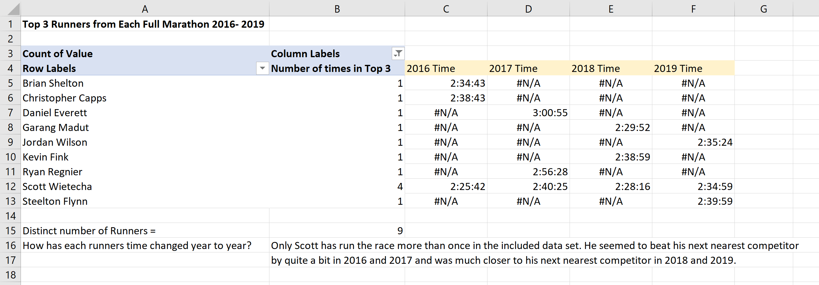
Bonus Answers:

Slide 14
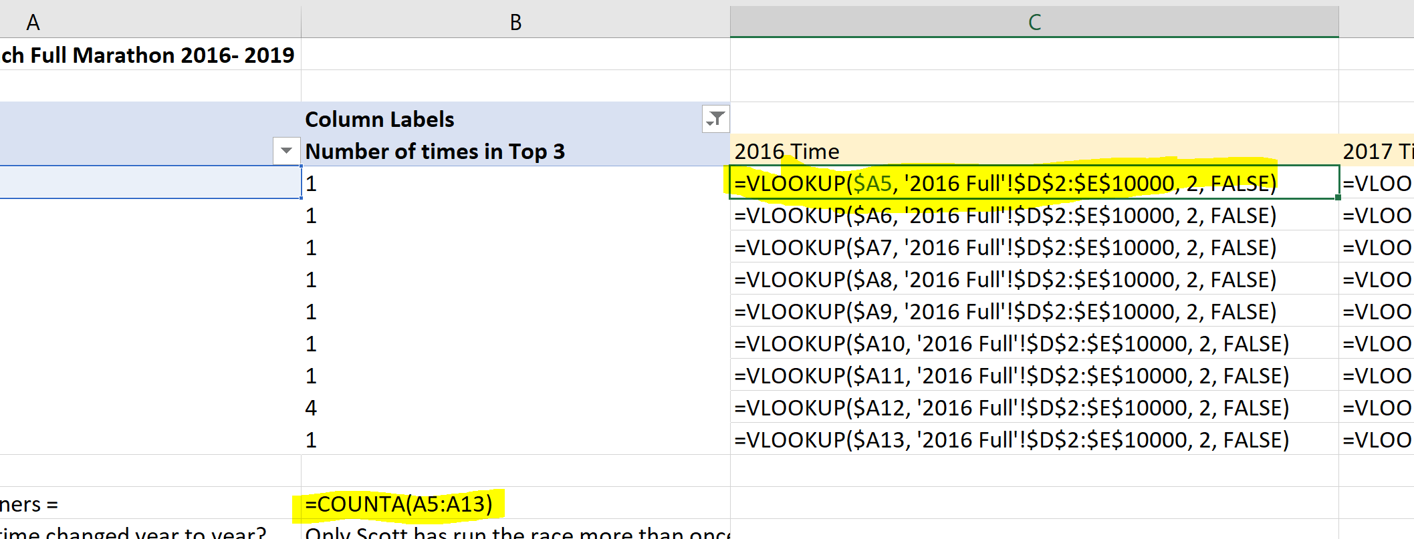
Bonus Formulas:

